Slide 1
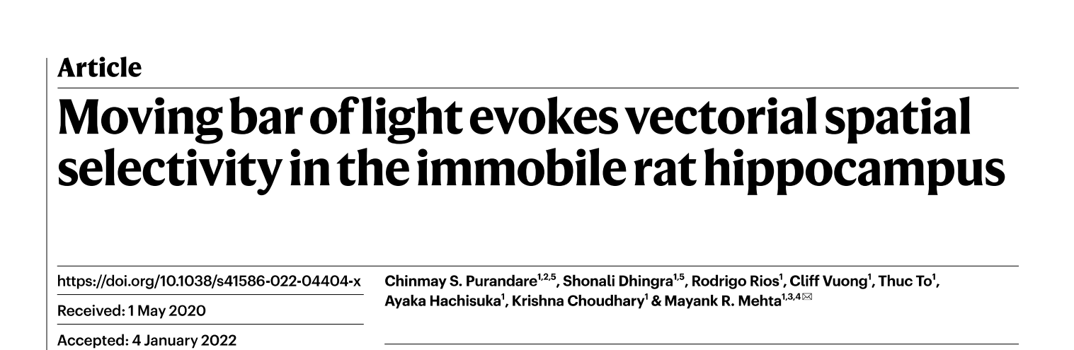

Slide 2
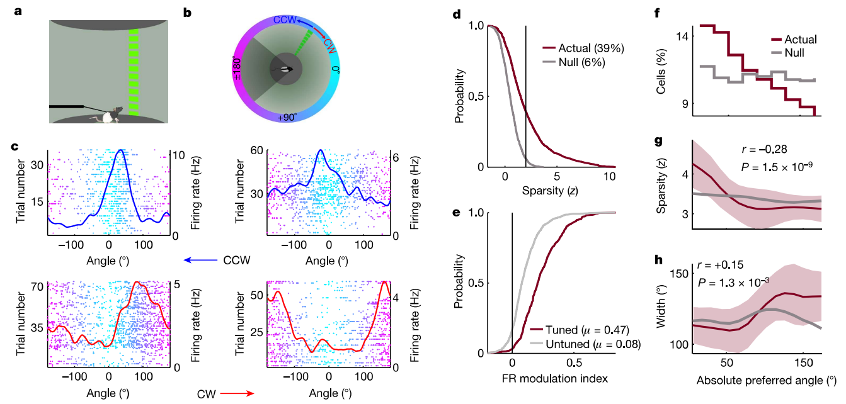

Slide 3
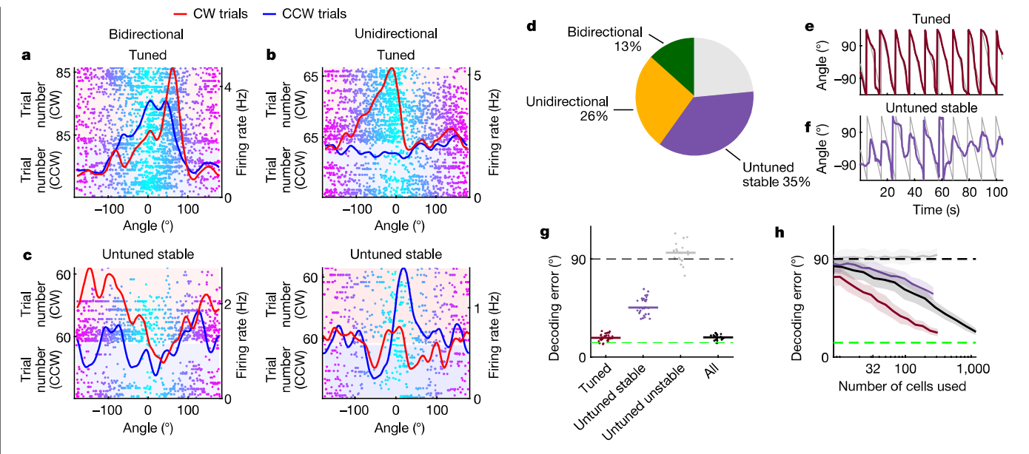

Slide 4
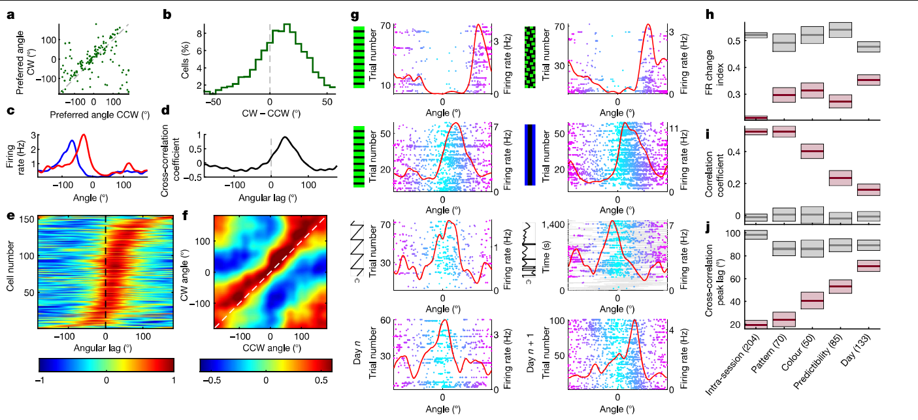
Visual information to reach the rat hippocampus from the retina: 274 milliseconds

Slide 5
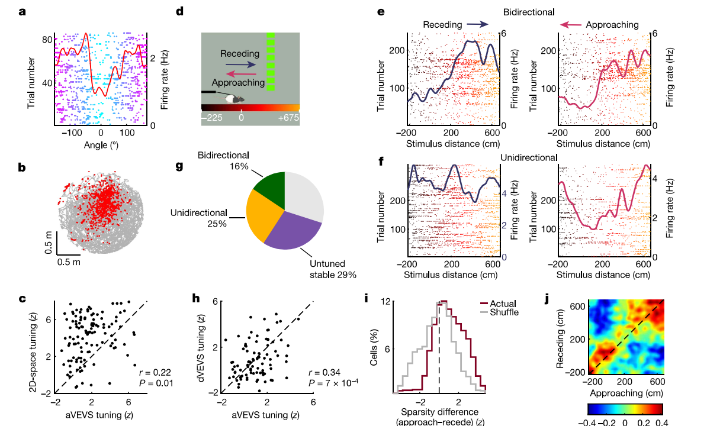
Majority of hippocampal "place cells" encode angle, distance and direction of motion of a moving bar of light in an immobile rat, without any task or reward.

Slide 6
Summary
Firing specificity of the hippocampus for moving objects without reward, memory or task demand.
Unlike place cells VEVS showed significant activity outside the preferred zone.
aVEVS are retrospective compared to places cells which are prospective.
aVEVS are relatively unchanged by changes in predictability or sequential nature of the stimuli
Many aVEVS are also place cells.

